Slide 1
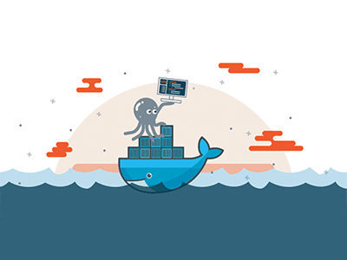

Introduction to docker

Slide 2
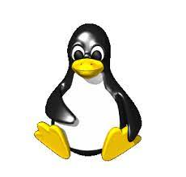
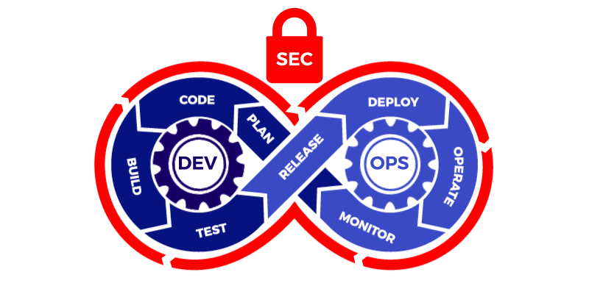



Introduction to docker
Topics
Hypervisors.
Virtualization.
Virtual Machines | Containers | Serverless Computing.
LXC.
VMs | LXC | Application Containers.
Introduction To Docker.
Why Containers? Problems That Containerization Solves.
Microservices.
Practical Implementation I (Container Operations, States, And Basic Commands).
Custom Images (Export\Import Tarball, Commit, And Dockerfile).
Layered Architecture.
Multi-stage Builds.
Port Mapping.
Volumes.
Practical Implementation II (Image Operations, Volumes, And Port Mapping).
Deep Dive In Docker Networking (Bridge, Host, And None).
Docker Compose.
Practical Implementation III (Docker Networking).
Best Practices.
What’s Next? (Kubernetes, Ansible, GitHub Actions, Jenkins etc.).
Tashik Moin Sheikh Microsoft Gold Ambassador | MCT | MCSA | MCP

Slide 3
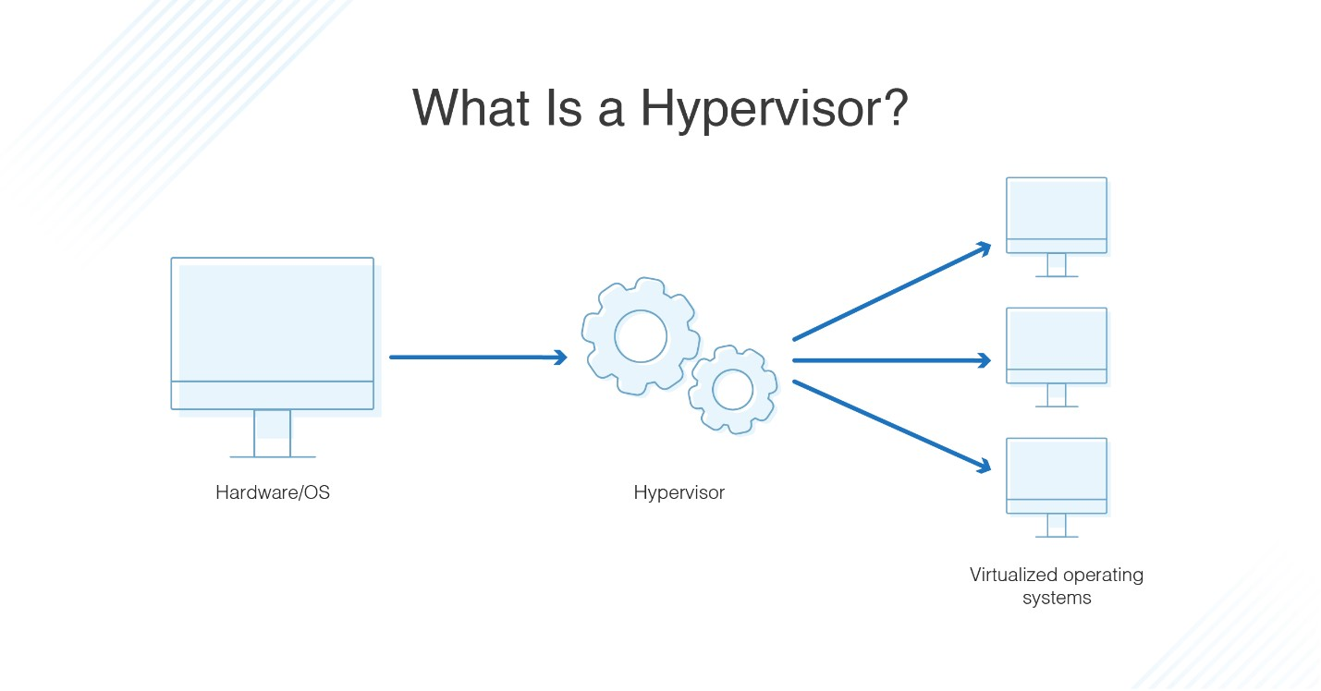
Hypervisor
A hypervisor, also known as a virtual machine monitor or VMM, is software that creates and runs virtual machines (VMs). A hypervisor allows one host computer to support multiple guest VMs by virtually sharing its resources, such as memory and processing.

Slide 4
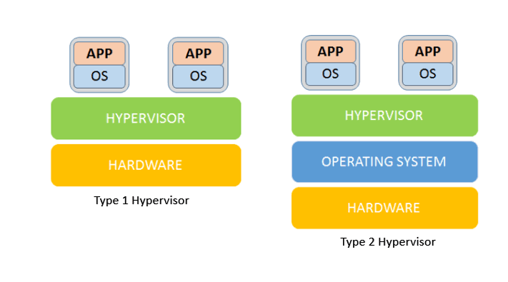
Bare metal (Type 1) vs hosted (type 2)
ESXi, Hyper-V, and Apple Boot Camp etc.
MSFT Virtual PC, Virtual Box, VMware Workstation etc.

Slide 5
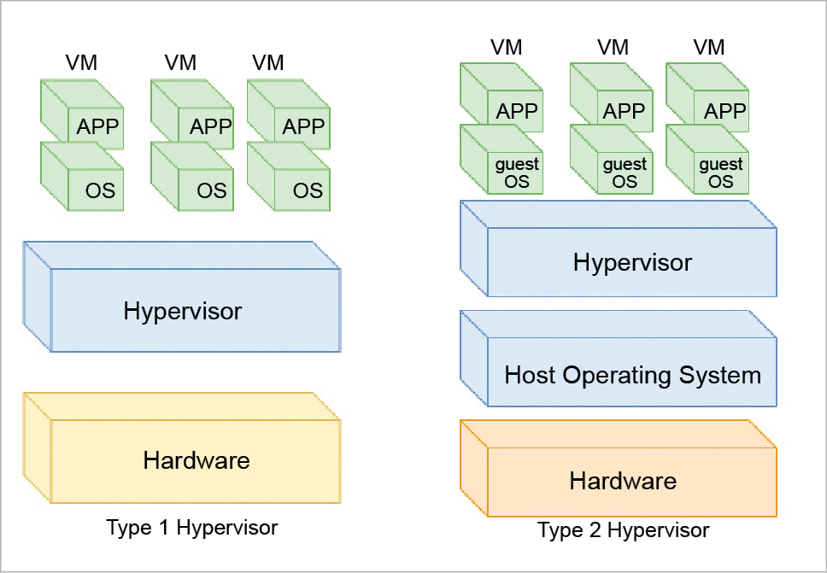

Slide 6
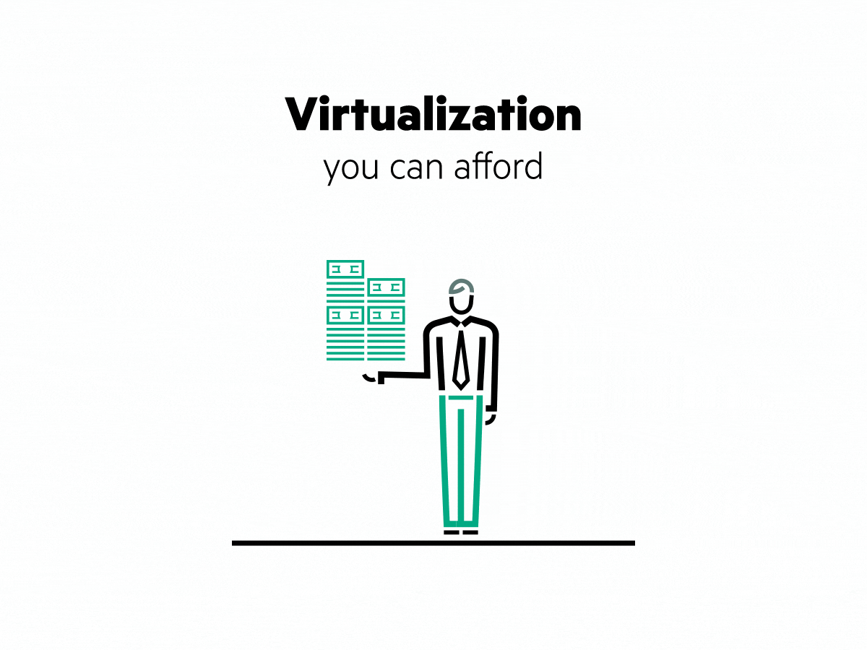
virtualization
Virtualization is the process of running a virtual instance of a computer system in a layer abstracted from the actual hardware. Most commonly, it refers to running multiple operating systems on a computer system simultaneously. Virtualization is the creation of a virtual -- rather than actual -- version of something, such as an operating system (OS), a server, a storage device or network resources. Virtualization uses software that simulates hardware functionality in order to create a virtual system Virtualization refers to the creation of a virtual resource such as a server, desktop, operating system, file, storage or network. The main goal of virtualization is to manage workloads by radically transforming traditional computing to make it more scalable.

Slide 7
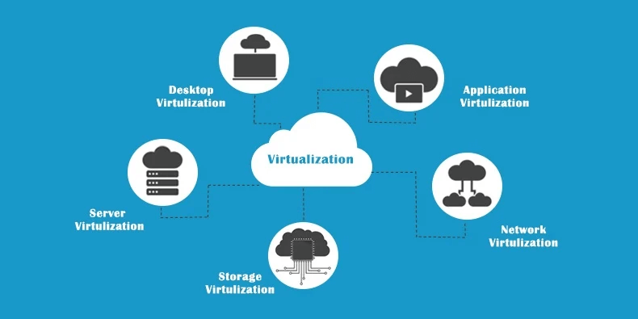

Slide 8
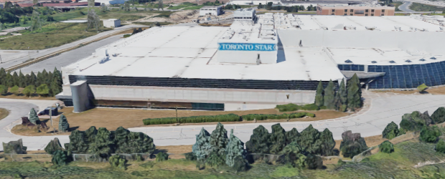
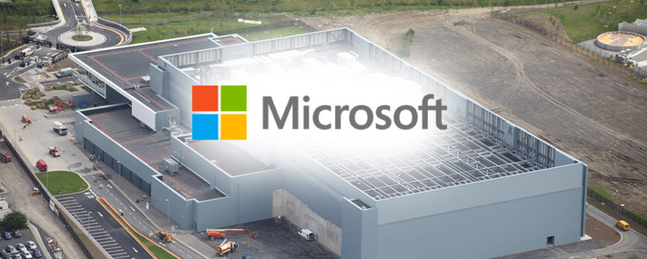
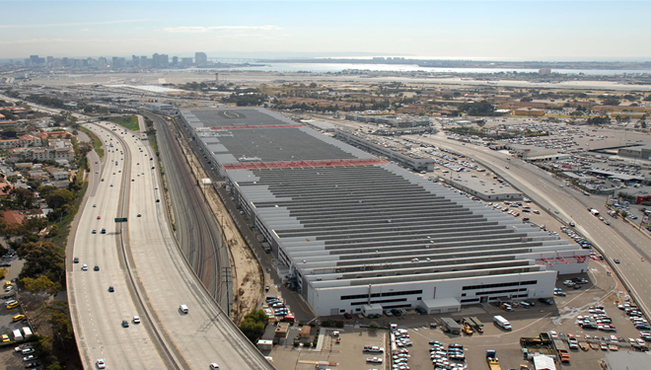
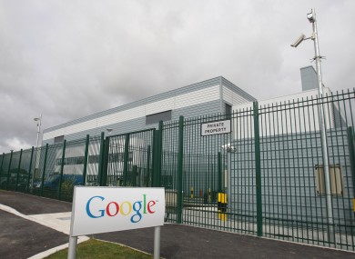
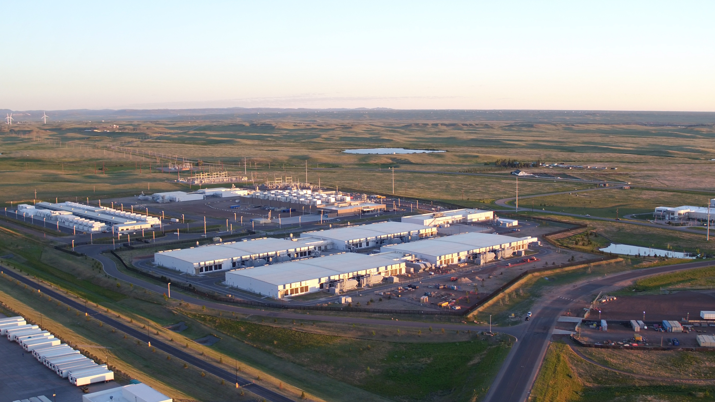
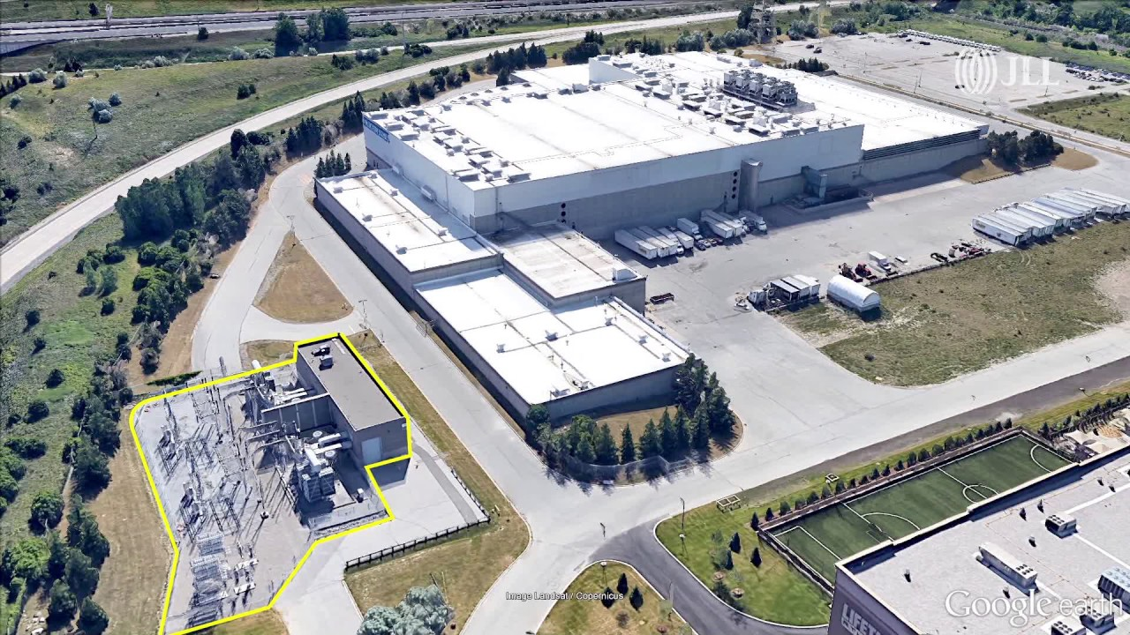

Slide 9
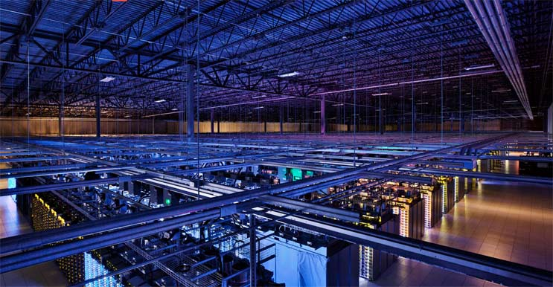
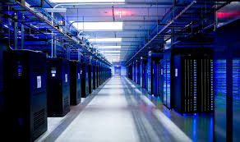
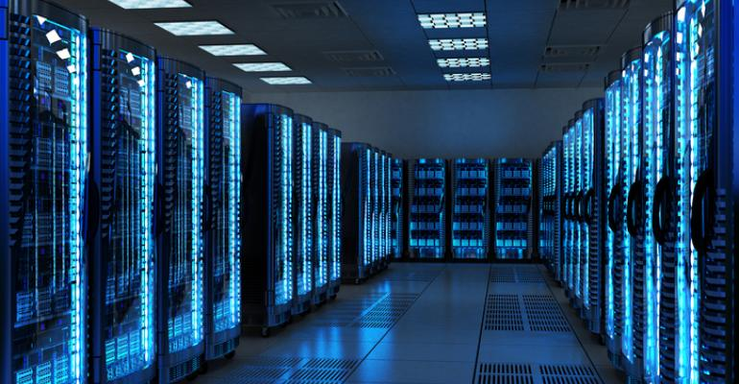
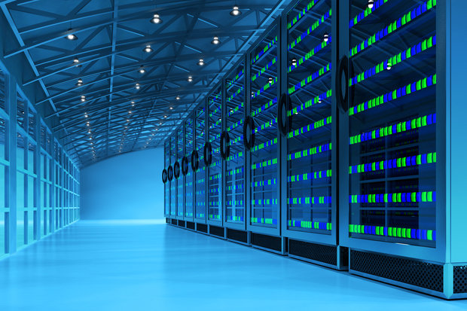

Slide 10
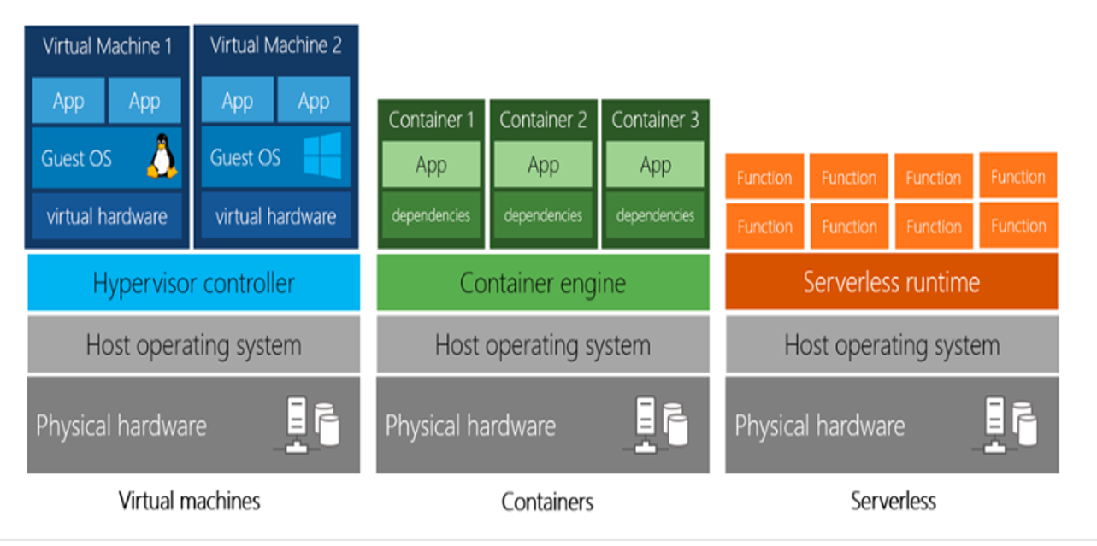
Virtual machines vs containers VS serverless

Slide 11
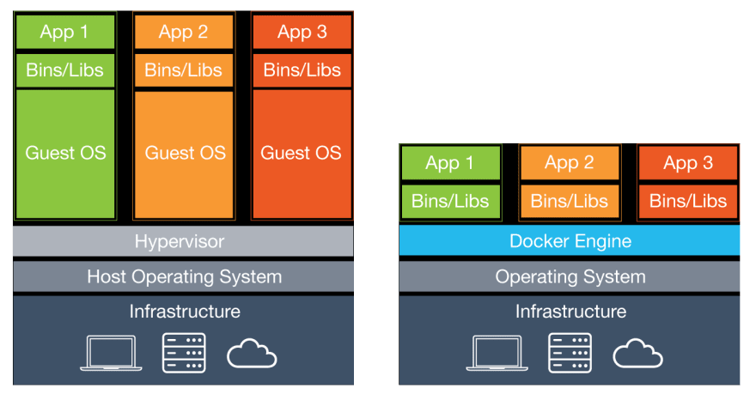
Virtual machines vs containers

Slide 12
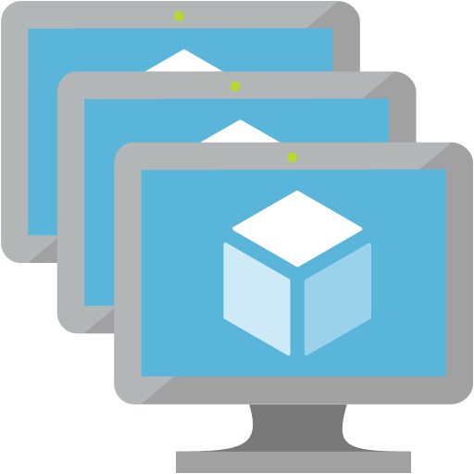
Virtual machines
Definition
Virtual machines are software computers that provide the same functionality as physical computers. Like physical computers, they run applications and an operating system. However, virtual machines are computer files that run on a physical computer and behave like a physical computer. In other words, virtual machines behave as separate computer systems.
Types Of Virtual Machines Process Virtual Machines Execute computer programs in a platform-independent environment. It masks the information of the underlying hardware or operating system. This allows the program to be executed in the same fashion on any platform. Example : JVM, .NET Core CLR etc.
System Virtual Machines
Support the sharing of a host computer’s physical resources between multiple virtual machines.
Example : Virtual Machines Created From VMware.

Slide 13
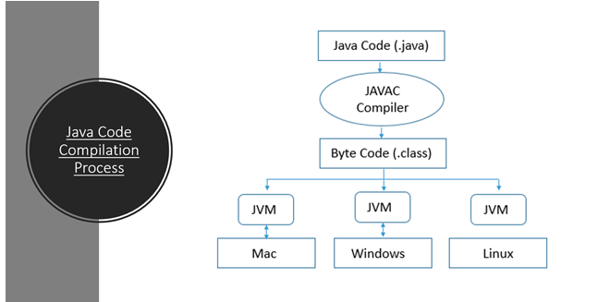

Slide 14
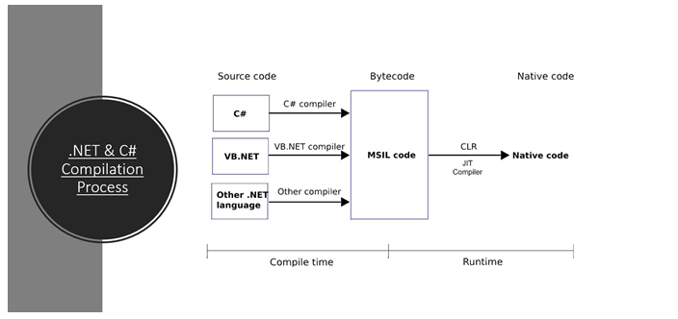

Slide 15
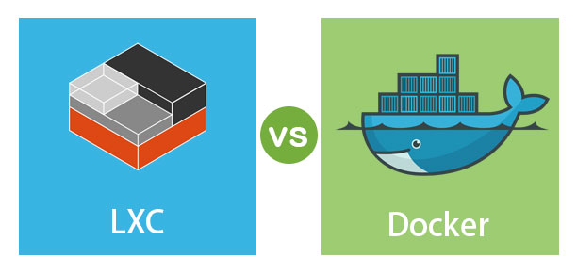

Slide 16
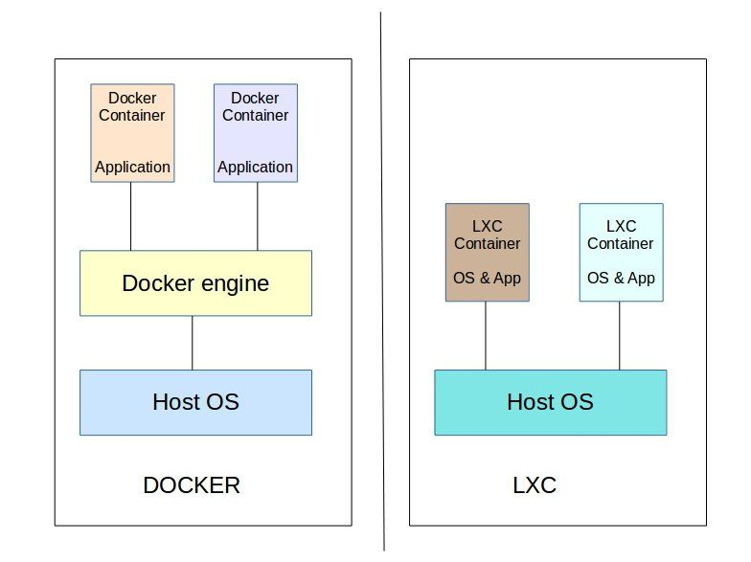
Linux containers (Lxc)
LXC is a user space interface for the Linux kernel containment features. Through a powerful API and simple tools, it lets Linux users easily create and manage system or application containers. LXC containers are often considered as something in the middle between a chroot and a full fledged virtual machine. The goal of LXC is to create an environment as close as possible to a standard Linux installation but without the need for a separate kernel. Reference: https://linuxcontainers.org/lxc/introduction/

Slide 17
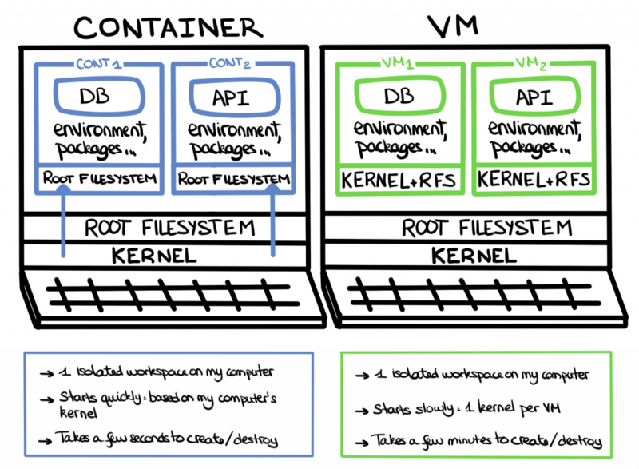
Containers uses the same host machine’s kernel instead of using a separate kernel but they have separate file systems.

Slide 18
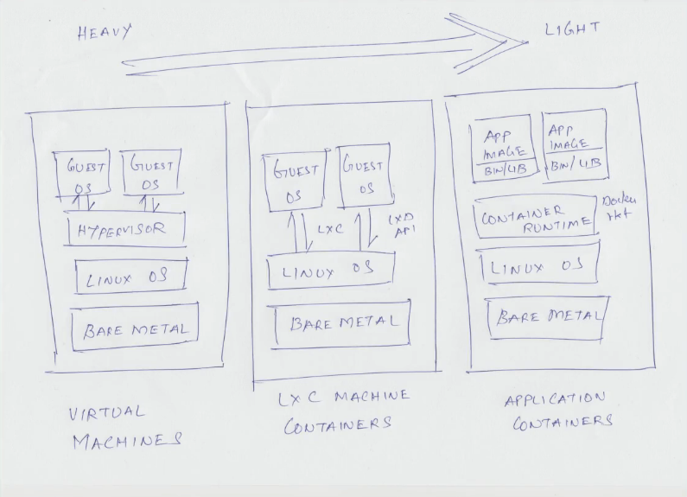

Slide 19
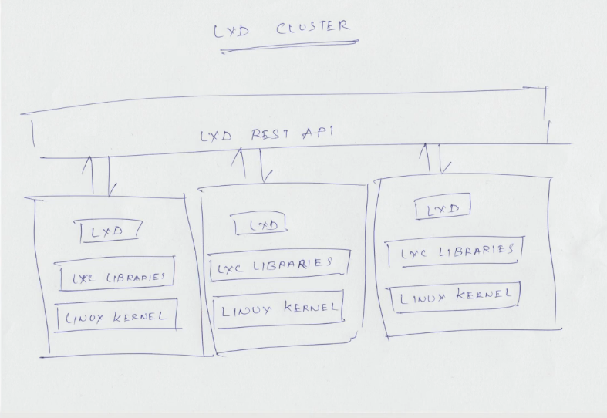

Slide 20
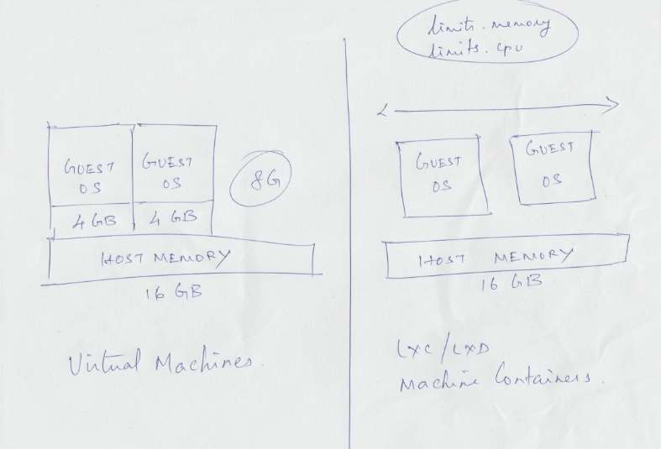

Slide 21
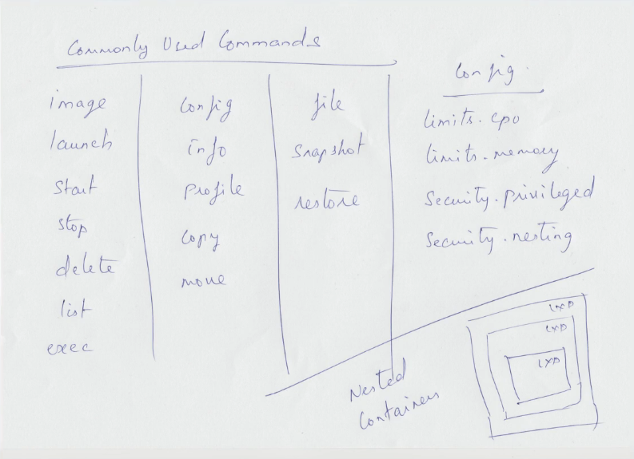

Slide 22
Virtual Machines - Heavy
- Fixed memory, and CPU cores for each GuestOS (Non-sharable). LXC using LXD REST API Interface
- Lightweight than VMs.
- Uses LXD API to make LXC containers. - Each GuestOS can use entire hardware resources together (Memory, and CPU cores).
- We can also limit memory, and CPU core just like VMs.
- Nested LXC containers are possible.
- Each GuestOS uses the same host OS Kernel.
- LXC containers are used for running multiple applications in an isolated environment.
- Fast than VMs. - How to make an LXC? https://www.youtube.com/watch?v=CWmkSj_B-wo - More on LXC, https://www.upguard.com/blog/docker-vs-lxc Application Containers
- More lightweight than LXC.
- Uses same host machine kernel.
- Docker containers(Application containers) are made for running single application per container.
- No need to worry about RAM, Space, CPU and other resource allocations for contaienrs.
- Fast than LXC.

Slide 23
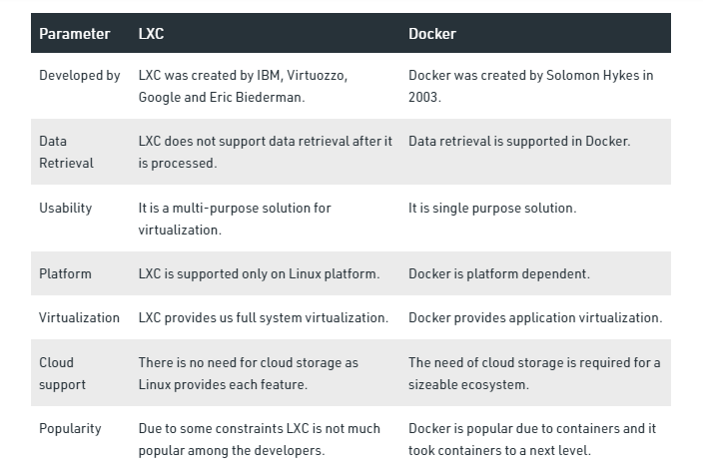

Slide 25
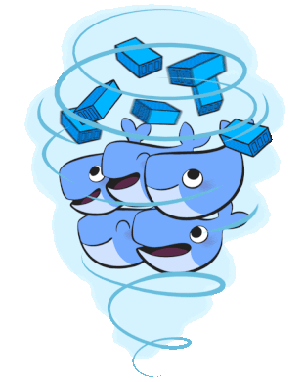
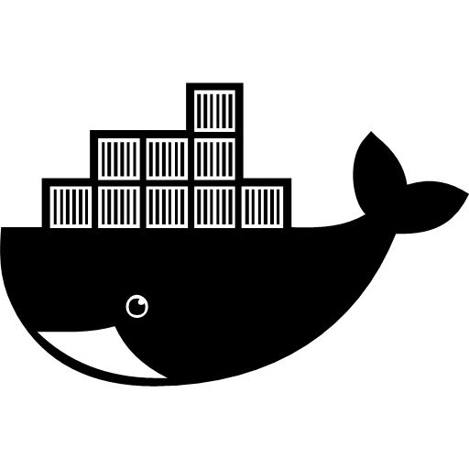
docker
Docker is a set of platform as a service products that use OS-level virtualization to deliver software in packages called containers. Containers are isolated from one another and bundle their own software, libraries and configuration files; they can communicate with each other through well-defined channels. – Wikipedia.

Slide 26
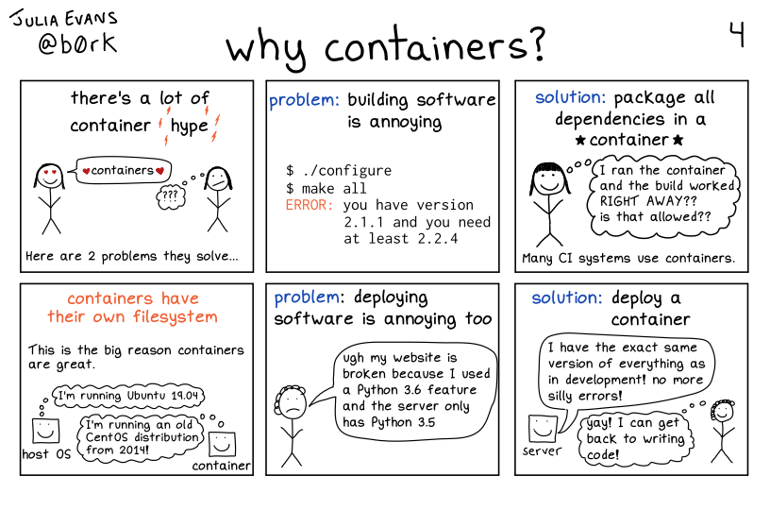

Slide 27
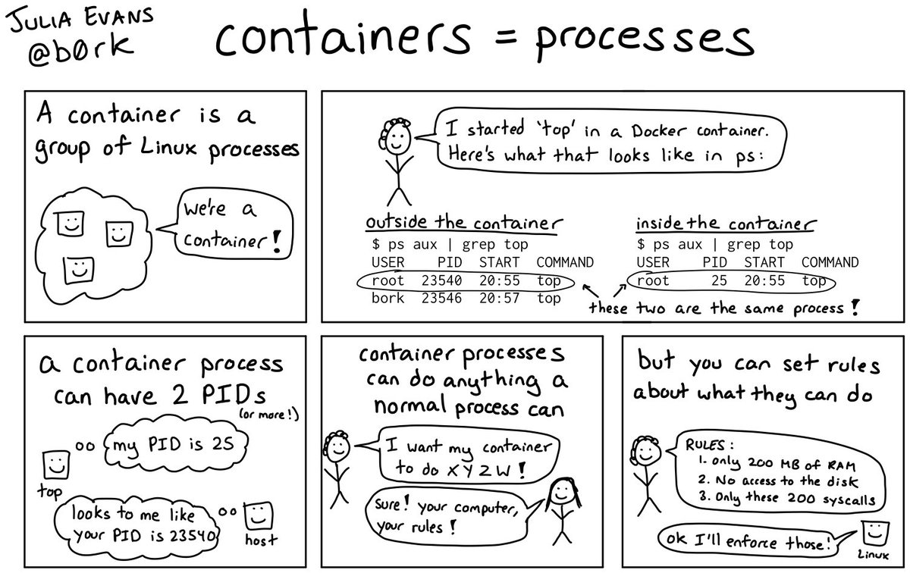

Slide 28
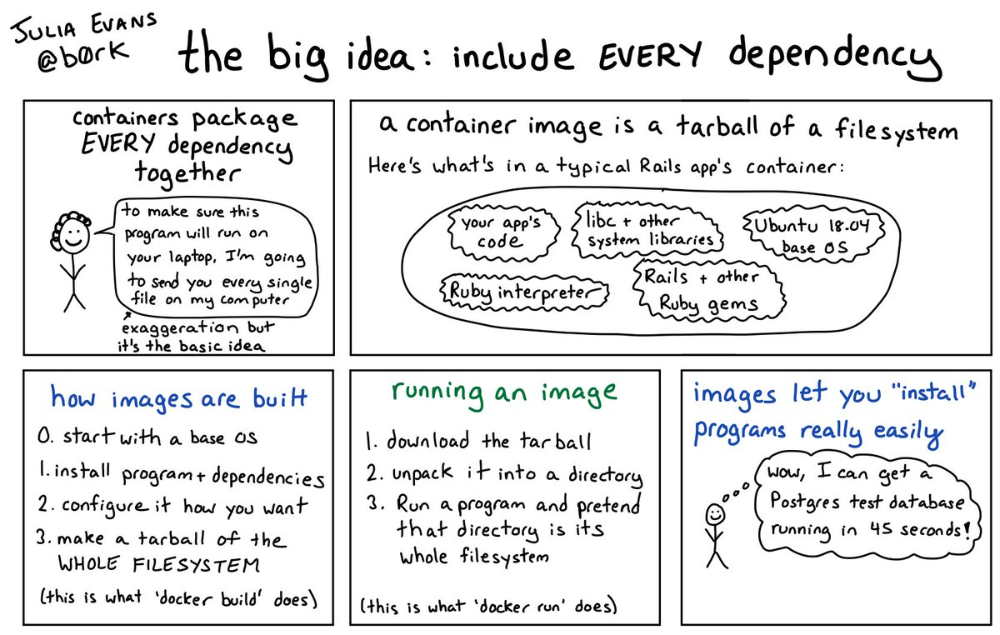

Slide 29
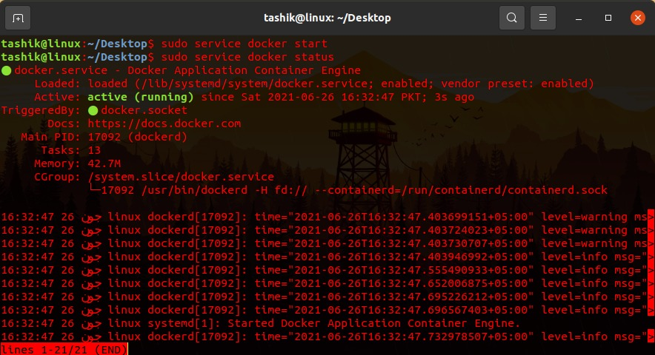
← Shows status of docker engine.

Slide 30
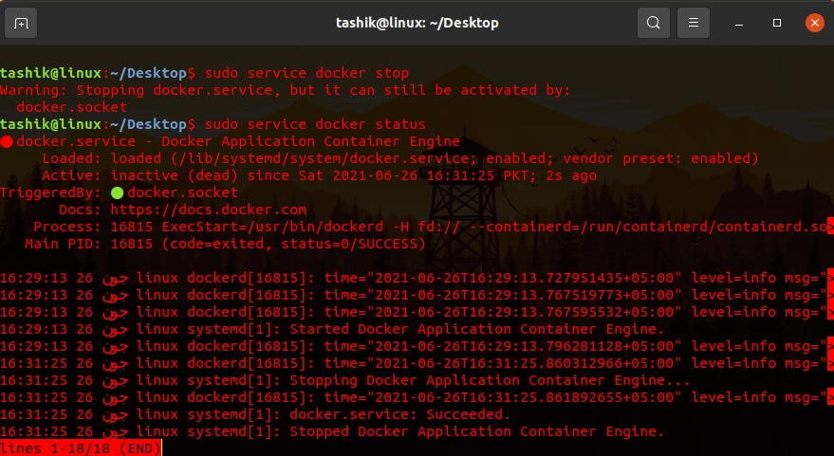
← Shows status of docker engine.

Slide 31
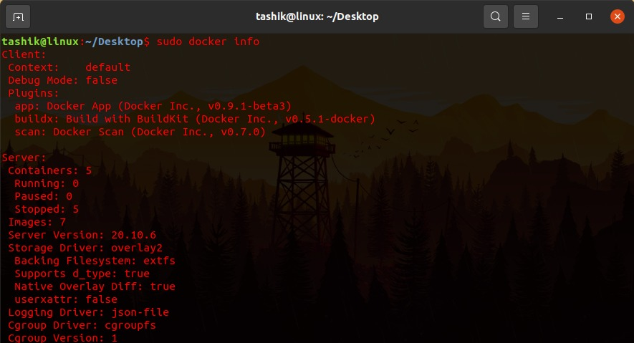
← Gives information about containers, version, driver, filesystem etc.

Slide 32
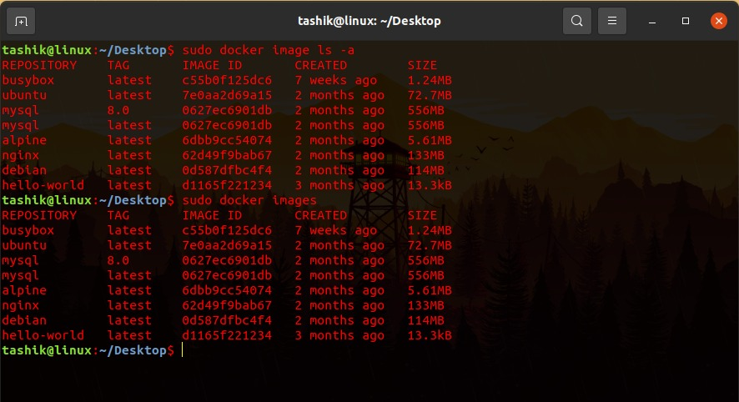
← Lists total images available at host machine.

Slide 33
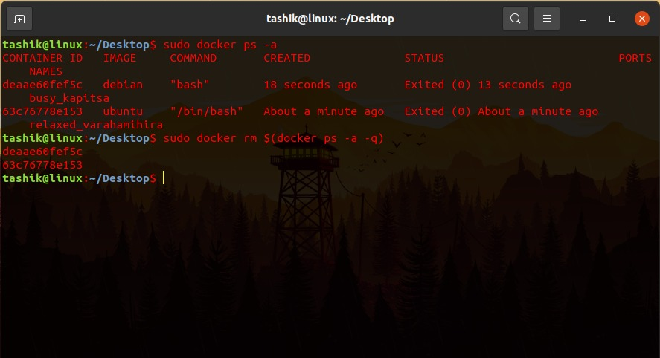
← Removes all the containers having state stop.

Slide 34
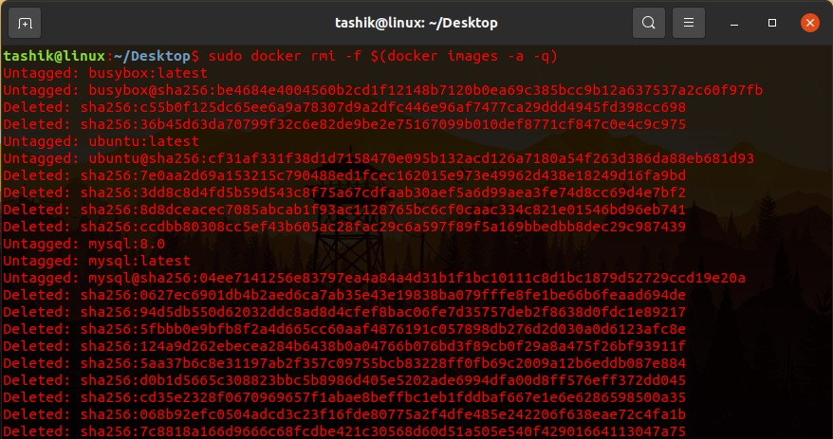
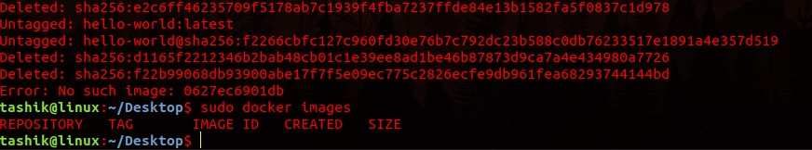
← Removes all the images.

Slide 35
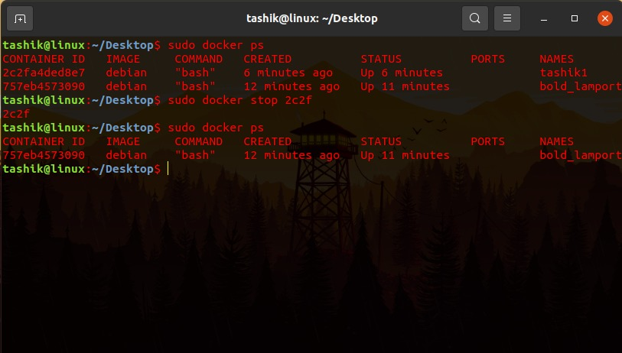
← Stops the running container.

Slide 36
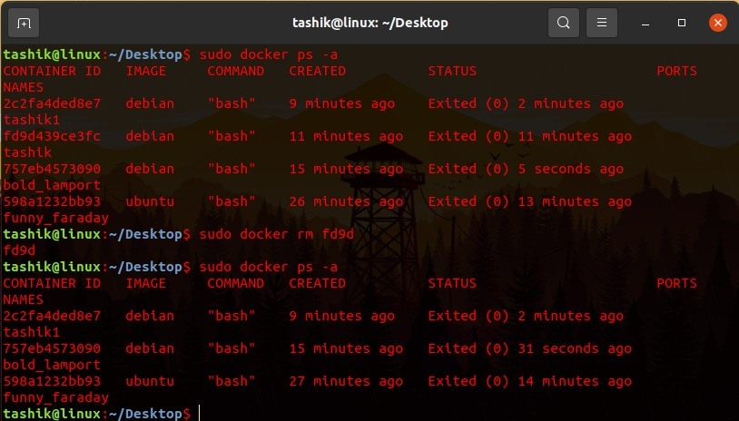
← Removes container having any id/name __.

Slide 37
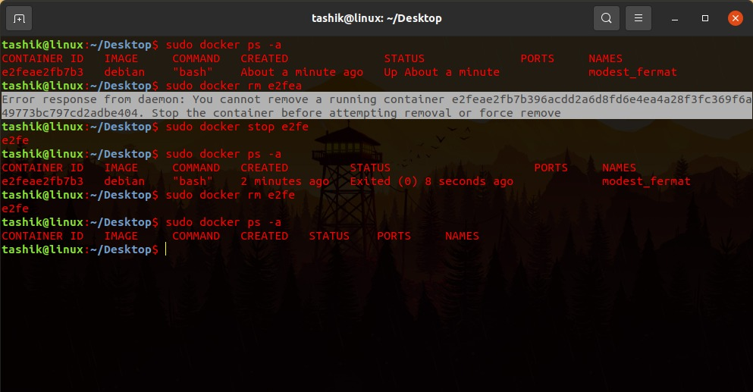

Slide 38
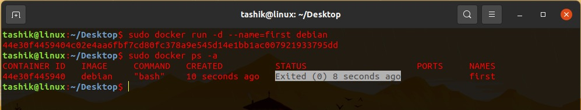
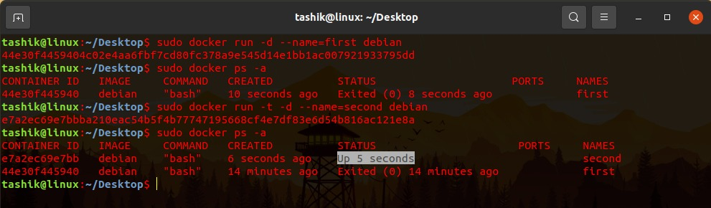

Slide 39
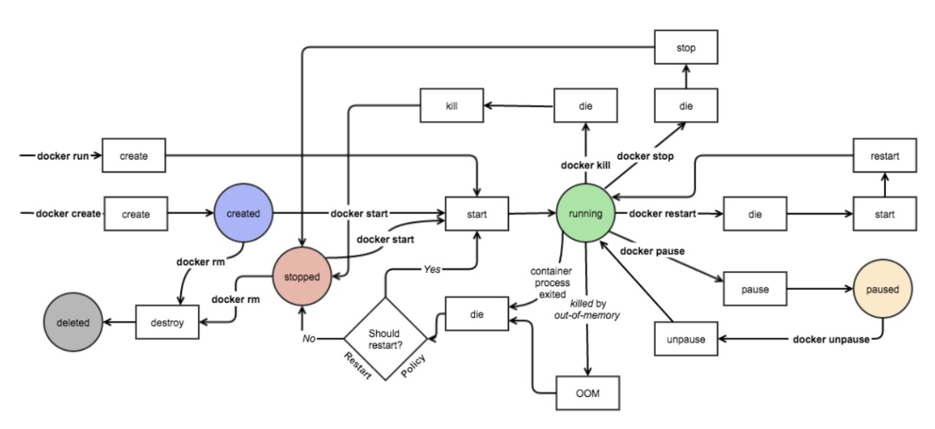

Slide 40
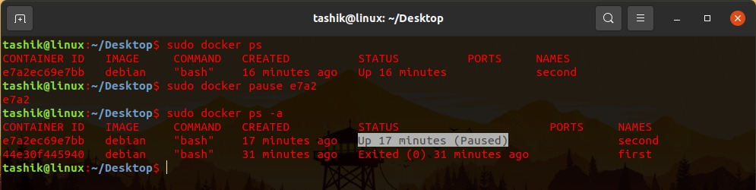


Slide 41


Slide 42


Slide 43


Slide 44


Slide 45


Slide 46


Slide 47


Slide 48


Slide 49


Slide 50


Slide 51


Slide 52


Slide 53


Slide 54


Slide 55


Slide 56


Slide 57


Slide 58


Slide 59


Slide 60


Slide 61


Slide 62


Slide 63


Slide 64


Slide 85
Docker Networking

Slide 86


Slide 87


Slide 88


Slide 89


Slide 90


Slide 91


Slide 92


Slide 93


Slide 94


Slide 95


Slide 96


Slide 97


Slide 98


Slide 99


Slide 100


Slide 101


